Slide 1

Project Phase I
Group JJNW
Represented by John and Josh

Slide 2

Introduction
What are we creating?
A web application to buy, sell and bid on game content.
Sellers will be able to set the price of the content and potential put items up for free.
A front end for user interaction on top of a backend for processing and database connection.

Slide 3

Added Functions
Delivery
The delivery of items will be dependent on the type of content.
Shop
User viewable shop displaying content for sale.
Wish list
Users will be able to save and rank items for later purchase.

Slide 4
Other Functions…
Browsing
Searching
Sale
Biding
Order and sales report
Registered Users
Suppliers
Ratings

Slide 5

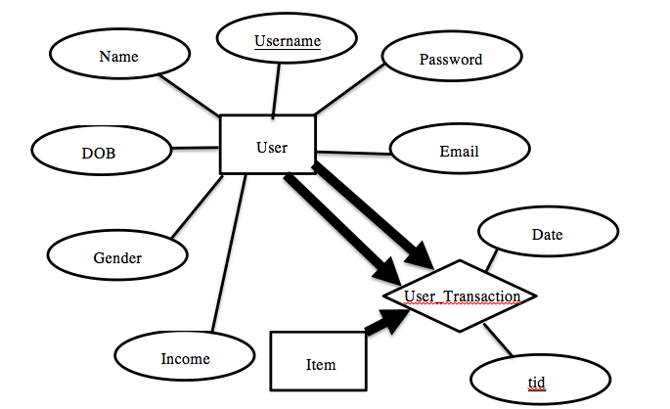
Entity-Relation Diagrams
User Entity and User_Transaction Relationship

Slide 6
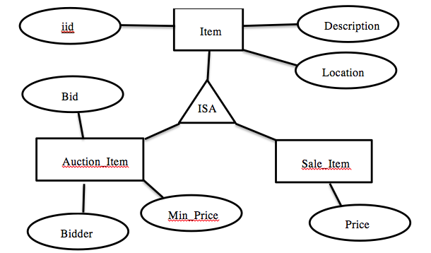
Entity-Relation Diagrams
Item Entity-Relations

Slide 7
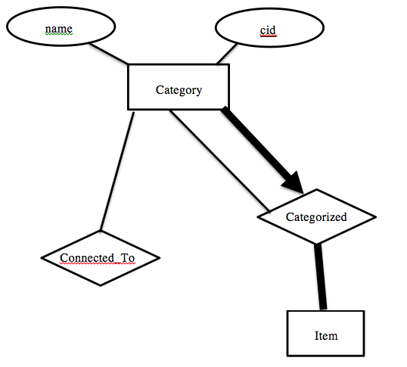
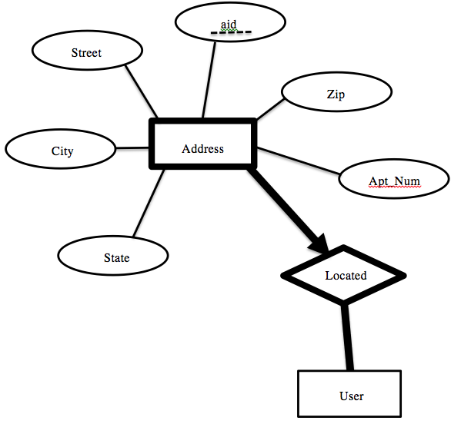
Entity-Relation Diagrams
Category Entity Relationship
Address Entity Relationship

Slide 8
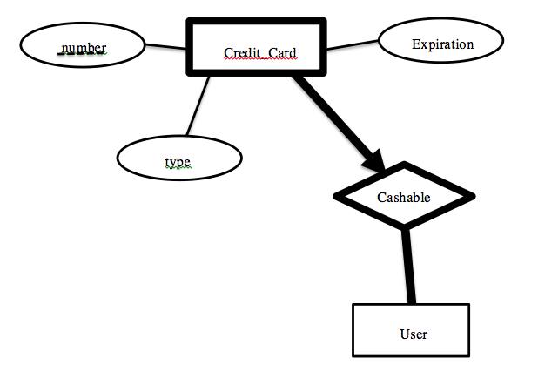
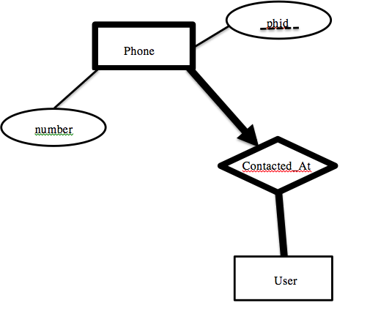
Entity-Relation Diagrams
Phone Entity-Relationship
Credit Card
Entity-Relationship

Slide 9
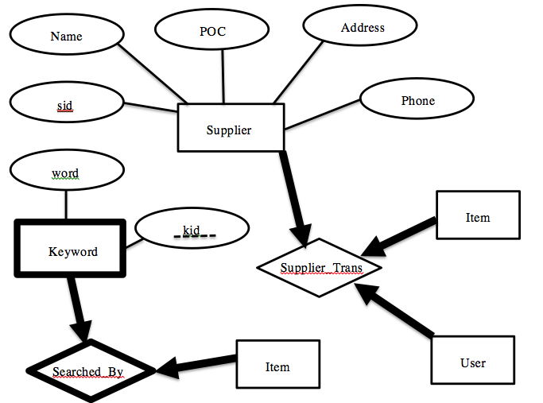
Entity-Relation Diagrams
Supplier Entity-Relationship

Slide 10
Entity-Relation Diagrams
Phone Entity-Relations
Credit Card
Entity-Relations

Slide 11
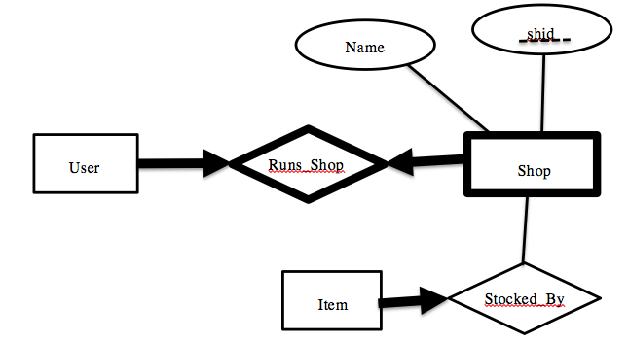
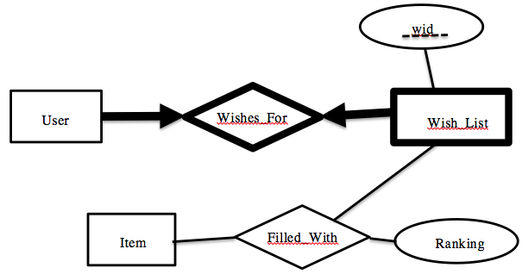
Entity-Relation Diagrams
Shop Entity-Relations
Wish list
Entity-Relations

Slide 12
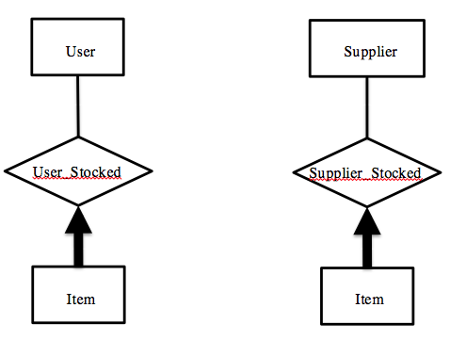
Entity-Relation Diagrams
User Stocked
Entity-Relationship
Supplier stocked
Entity-Relationship

Slide 13
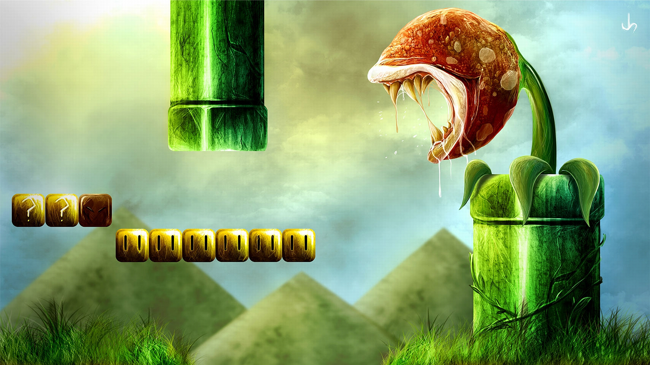
Thank you ☺
JJNW

